Slide 1
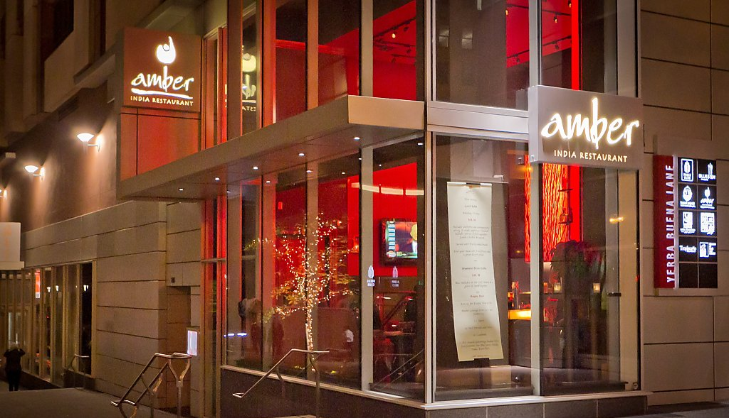
Amber India Restaurant
Group 5
Wei-Jung (Audrey) Liu
Yan (Ava) Zhang
David Hess

Slide 2
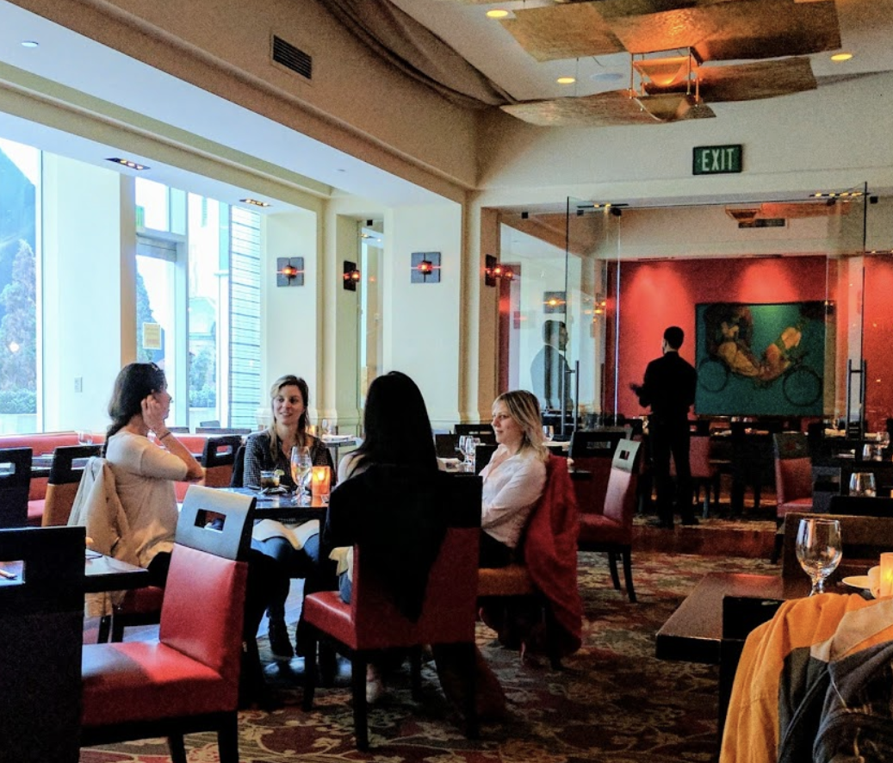

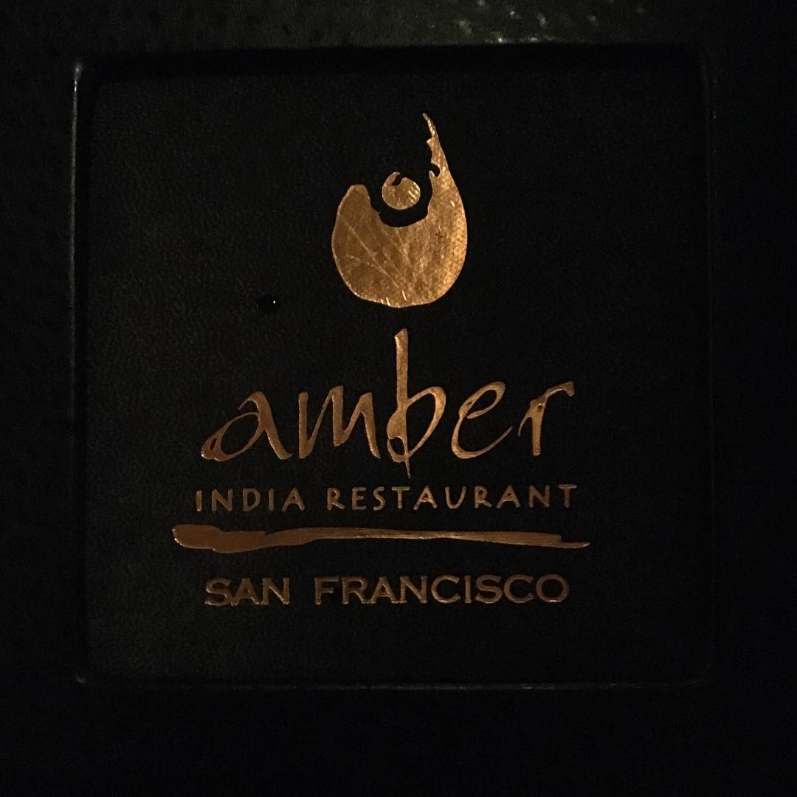
Business Questions
Our questions where about profitability:
Is the weekend or weekday more profitable?
Is lunch or dinner more profitable?
Is take-out less profitable because of the lack of alcohol and desserts purchased with dine-in orders?

Slide 3
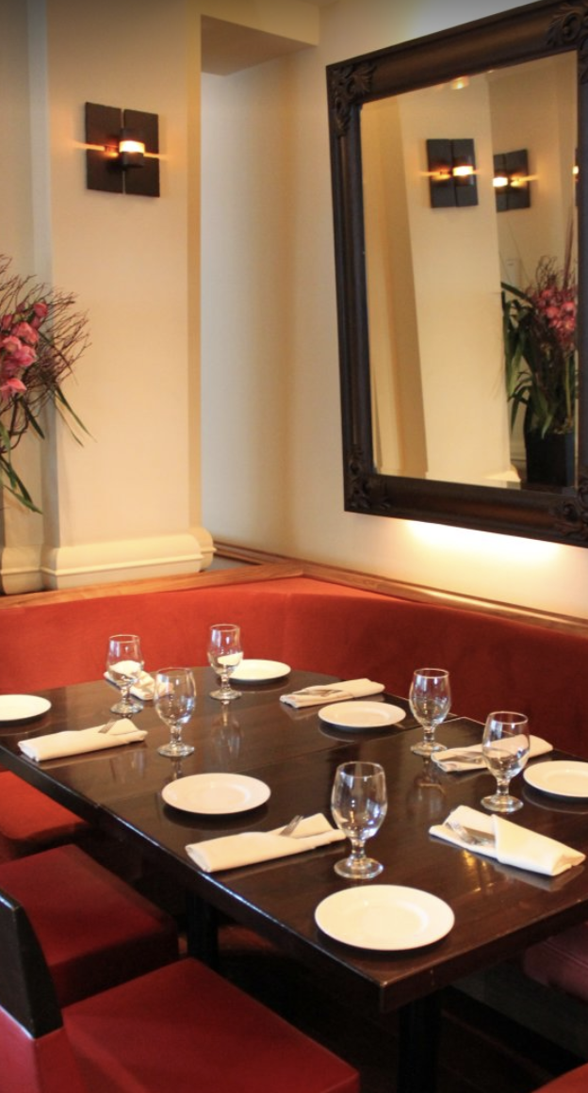
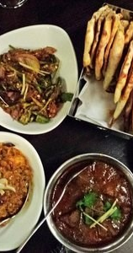
Creating our Tables
To answer our questions we needed two sets of data:
1. The Menu of Amber, including categories for the food, prices and profits
2. Daily Orders for Amber, what items are ordered, what day, lunch/dinner and takeout/dine-in

Slide 4
Menu Tables
Menu Table
MealAttribute Table
MenuID | Item | MealType | Price Structure
1 | Edamame and Potato | 1 | 1
2 | Chilli Chicken Dumpling | 2 | 2
3 | Kolkata Fish Fry | 3 | 3
MealType | MType | Subtype | MeatKey
1 | Appetizer | none | 1
4 | Appetizer | Soup | 1
5 | Entrée | Clay Oven | 2
Price Table
MeatKey Table
VegType Table
Price Structure | Price | Profit
1 | 10 | 3
2 | 15 | 3
3 | 16 | 4
MeatKey | MeatName
1 | none
2 | chicken
3 | fish
MeatKey | Veg
1 | yes
2 | no
3 | no

Slide 5
Order Tables
TimeKey Table
TimeID | OrderDay | OrderTime | Takeout
1 | Monday | lunch | yes
2 | Monday | lunch | no
8 | Tuesday | dinner | no
OrderTime Table
OrderID | TimeID
1 | 1
2 | 2
3 | 6
Price Table
OrderID | MenuID | Qty
1 | 2 | 1
1 | 26 | 2
1 | 6 | 1
Links to the Menu Tables on the previous slide through MenuID

Slide 6
Business Question #1:
Is the weekend or weekday more profitable?
To answer this question we first created the following VIEW:
CREATE VIEW ProfitTable AS
SELECT ol.OrderID, ol.Qty, tk.OrderDay, tk.OrderTime, tk.Takeout,
(pt.Price * ol.Qty) AS TotalPrice, (pt.Profit * ol.Qty) AS TotalProfit
FROM OrderList ol INNER JOIN OrderTime ot ON ol.OrderID = ot.OrderID
INNER JOIN TimeKey tk ON ot.TimeID = tk.TimeID
INNER JOIN Menu m ON ol.MenuID = m.MenuID
INNER JOIN PriceTable pt ON m.PriceStructure = pt.PriceStructure;

Slide 7
Business Question #1:
Is the weekend or weekday more profitable?
SELECT * FROM ProfitTable LIMIT 4;
OrderID | Qty | OrderDay | OrderTime | Takeout | TotalPrice | TotalProfit
1 | 1 | Monday | lunch | yes | 15 | 3
1 | 2 | Monday | lunch | yes | 34 | 8
1 | 1 | Monday | lunch | yes | 25 | 5
1 | 1 | Monday | lunch | yes | 27 | 6
Using this table we SELECT only rows where OrderDay = ‘Monday’ – ‘Thursday’ for Weekday and
‘Friday’ – ‘Sunday’ for Weekend.
Then we sum over all the Price and Profit.
Finally we take a ratio of profit to price .

Slide 8
Business Question #1:
Is the weekend or weekday more profitable?
We use UNION to combine the Weekday and Weekend Result Tables and our mock data reveals:
TtlProfit | TtlPrice | ProfitRatio | TimeOfWeek
430 | 1429 | 0.3009 | Weekend
556 | 1641 | 0.3388 | Weekday
There is no major difference between the weekend and weekday in our mock data.

Slide 9
Business Question #2:
Does lunch and dinner have the same profit margins?
We again use the VIEW ProfitTable with the following code:
SELECT OrderTime, (SUM(TotalProfit)) AS TtlProfit, (SUM(TotalPrice)) AS TtlPrice,
((SUM(TotalProfit))/(SUM(TotalPrice))) AS ProfitRatio
FROM ProfitTable
GROUP BY OrderTime;
OrderTime | TtlProfit | TtlPrice | ProfitRatio
lunch | 580 | 1771 | 0.3275
dinner | 406 | 1299 | 0.3125
There is no major difference between the lunch and dinner in our mock data.

Slide 10
Business Question #3:
Does take out service significantly increase profit margin since most
take-out orders don’t contain high margin items such
as alcoholic beverages and desserts.
First we create a new VIEW MealTypeProfit that brings in meal attributes to the profit table.
OrderID | Qty | OrderDay | OrderTime | Takeout | MType | TotalPrice | TotalProfit
1 | 1 | Monday | lunch | yes | Appetizer | 15 | 3
1 | 2 | Monday | lunch | yes | Entree | 34 | 8
1 | 1 | Monday | lunch | yes | Entree | 25 | 5
1 | 1 | Monday | lunch | yes | Entree | 27 | 6

Slide 11
Business Question #3:
Does take out service significantly increase profit margin since most
take-out orders don’t contain high margin items such
as alcoholic beverages and desserts.
Use this VIEW to calculate our profit metrics using a GROUP BY on the MealType
MType | TtlProfit | TtlPrice | ProfitRatio
Appetizer | 93 | 389 | 0.2391
Entree | 439 | 2057 | 0.2134
Bread | 16 | 35 | 0.4571
Dessert | 70 | 119 | 0.5882
Alcohol | 368 | 470 | 0.783
Alcohol and Dessert clearly have
much higher profit margins.
But are they a large enough part of each
order to significantly change the profit
ratios of take-out versus dine-in?

Slide 12
Business Question #3:
Does take out service significantly increase profit margin since most
take-out orders don’t contain high margin items such
as alcoholic beverages and desserts.
Use the ProfitTable VIEW to calculate our profit metrics using a GROUP BY on the Takeout
Takeout | TtlProfit | TtlPrice | ProfitRatio
yes | 198 | 912 | 0.2171
no | 788 | 2158 | 0.3652
Yes! We see a large difference in
Profit Margin between takeout
and dine-in

Slide 13
Trigger:
Show the price changes between
updated price and the original price.
CREATE TABLE PriceChangeTable(
PriceStructure INT,
OldPrice INT,
NewPrice INT,
PriceChange INT);
DELIMITER //
CREATE TRIGGER updateprice
BEFORE UPDATE
ON PriceTable FOR EACH ROW
BEGIN
IF OLD.Price != NEW.Price THEN
INSERT INTO PriceChangeTable VALUES
(OLD.PriceStructure, OLD.Price, NEW.Price,
NEW.Price-OLD.Price);
END IF;
END //
SET SQL_SAFE_UPDATES = 0;
UPDATE PriceTable SET Price = 12 WHERE PriceStructure = 1;
UPDATE PriceTable SET Price = 13 WHERE PriceStructure = 4;
UPDATE PriceTable SET Price = 27 WHERE PriceStructure = 6;
UPDATE PriceTable SET Price = 26 WHERE PriceStructure = 14;
UPDATE PriceTable SET Price = 6 WHERE PriceStructure = 16;
UPDATE PriceTable SET Price = 20 WHERE PriceStructure = 22;
UPDATE PriceTable SET Price = 16 WHERE PriceStructure = 25;
UPDATE PriceTable SET Price = 17 WHERE PriceStructure = 30;
SELECT Item, OldPrice, NewPrice, PriceChange
FROM PriceChangeTable pct
INNER JOIN Menu m
ON pct.PriceStructure=m.PriceStructure;

Slide 14
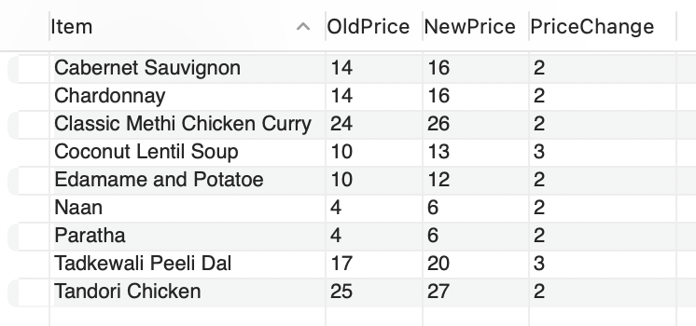
Trigger:
Show the price changes between
updated price and the original price.

Slide 15
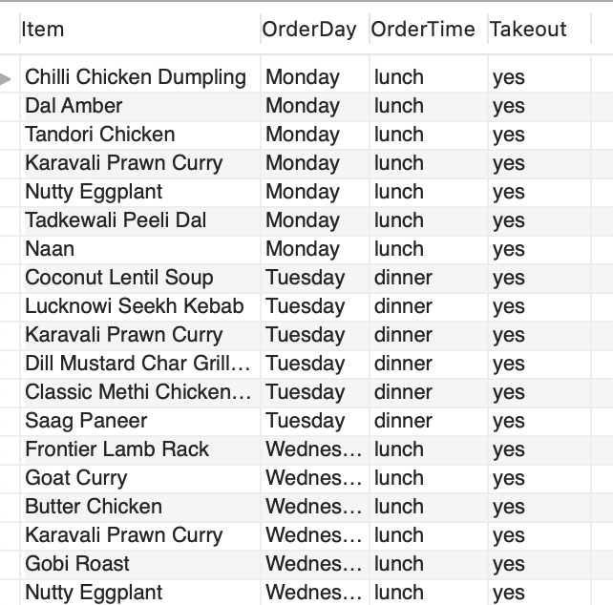
Stored Procedure:
Show the menu, order day and order time for only takeout orders.
DELIMITER $$
CREATE PROCEDURE takeoutmenu(
IN takeoutornot VARCHAR(100)
)
BEGIN
SELECT m.Item, tk.OrderDay, tk.OrderTime, tk.Takeout FROM Menu m
LEFT JOIN OrderList ol ON ol.MenuID = m.MenuID
LEFT JOIN OrderTime ot ON ot.OrderID=ol.OrderID
LEFT JOIN TimeKey tk ON tk.TimeID=ot.TimeID
AND (tk.Takeout=takeoutornot)
WHERE tk.Takeout IS NOT NULL;
END $$
DELIMITER ;
CALL takeoutmenu('yes');

Slide 16
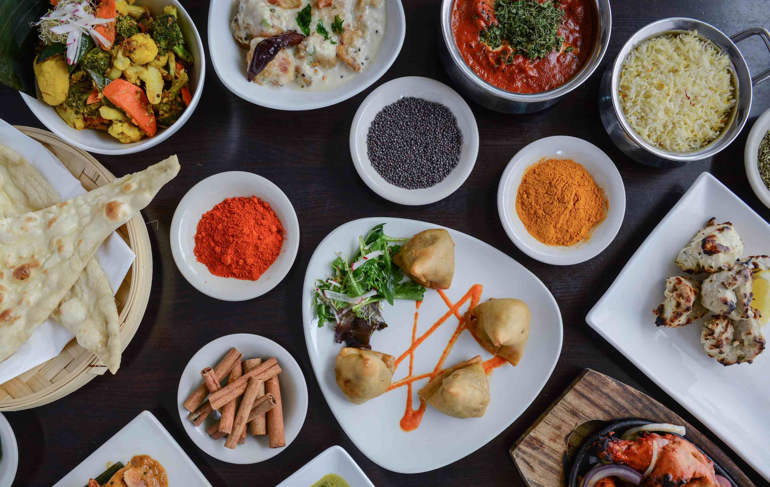
Thank you!
QUESTIONS?

